Slide 1
B.Tech Project Semester Presentation
Praneeth A S Anuroop Kakkirala

Slide 2
What we did??
The project involves the following main stages:
Identifying Space-Time interest points (STIP) in a video.
Applying K-Means clustering on STIP and building feature descriptors.
Using Multi-Class Support Vector Machine (One vs All) to train the agent to classify various classes of videos.

Slide 3
Data Set..
KTH Data Set
Contains 6 action classes (walking, jogging, running, boxing, hand waving, and hand clapping) .
Performed by 25 persons, 4 scenes and 6 action classes.
600 videos (100 of each class).
Video Details : Resolution = 160x120, Black & White, Used Static Camera, Homogeneous indoor/outdoor backgrounds.

Slide 4
Stage 1: Detecting Space-Time interest points
STIP: It either correspond to corners in a particular frame or instances of sudden variation in time occurring in the video.
We used Harris Detector to detect STIPs in a video clip.
Harris Detector: The algorithm relies on a central principle that, at a corner, the image intensity will change largely in multiple directions.

Slide 5
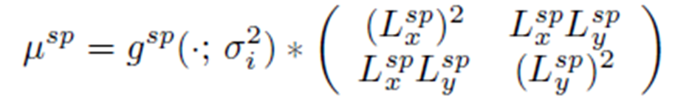
a) Interest points in spatial domain
In the spatial domain, points with a significant local variation of image intensities are called “Interest points”.
The idea of the Harris interest point detector is to detect locations in a spatial image ^{fsp} where the image values have significant variations in both directions.
For a given scale of observation σ_{l}²,interest points can be found as:
where L_{x}^{sp} and L_{y}^{sp} are
Gaussian derivatives

Slide 6
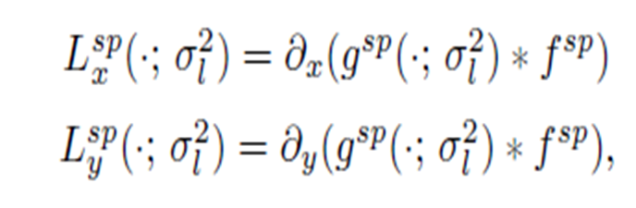
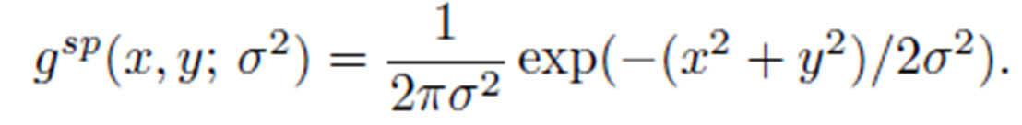
Interest points in spatial domain cont…
g^{sp} is the spatial Gaussian kernel
As the eigenvalues λ1, λ2, (λ1 ≤ λ2) of μsp represent characteristic variations of fsp, two significant values
of λ1, λ2 indicate the presence of an Interest Point. To detect such points, Harris proposed to detect
positive maxima of the corner function

Slide 7
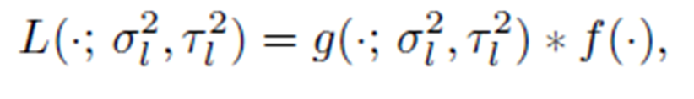
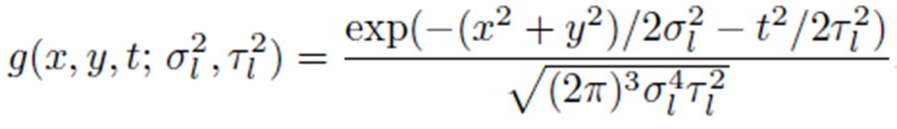
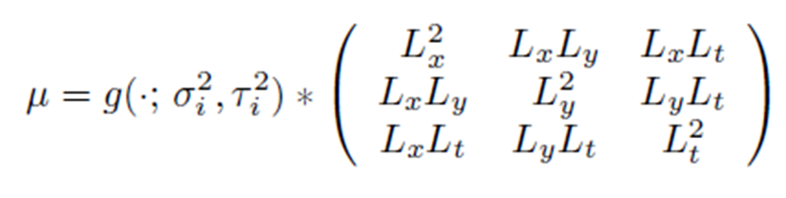
b) Interest points in the space-time
Similarly the equations to find the Interest points in the space-time domain are:

Slide 8
Algorithm
Compute horizontal and vertical derivatives of the image L_{x}^{sp} and L_{y}^{sp} .
Compute three images corresponding to three terms in the matrix µ
Convolute these three images with a larger Gaussian window (g).
Find local maxima and those detected as Interest points.

Slide 9
Stage 2 : K-means Clustering
Clustering is the classification of objects into different groups, or more precisely, the partitioning of a data set into subsets (clusters), so that the data in each subset (ideally) share some common trait - often according to some defined distance measure.
The k-means algorithm is an algorithm to cluster n objects based on attributes into k partitions, where k < n.

Slide 10
Stage 3: Multi Class SVM
A SVM is a binary classifier, that is, the class labels can only take two values: ± 1.
Many real-world problems, however, have more than two classes.
Used one-versus-all Multi SVM classifier.
Classification of new instances for the one-versus-all case is done by a winner-takes-all strategy, in which the classifier with the highest output function assigns the class

Slide 11
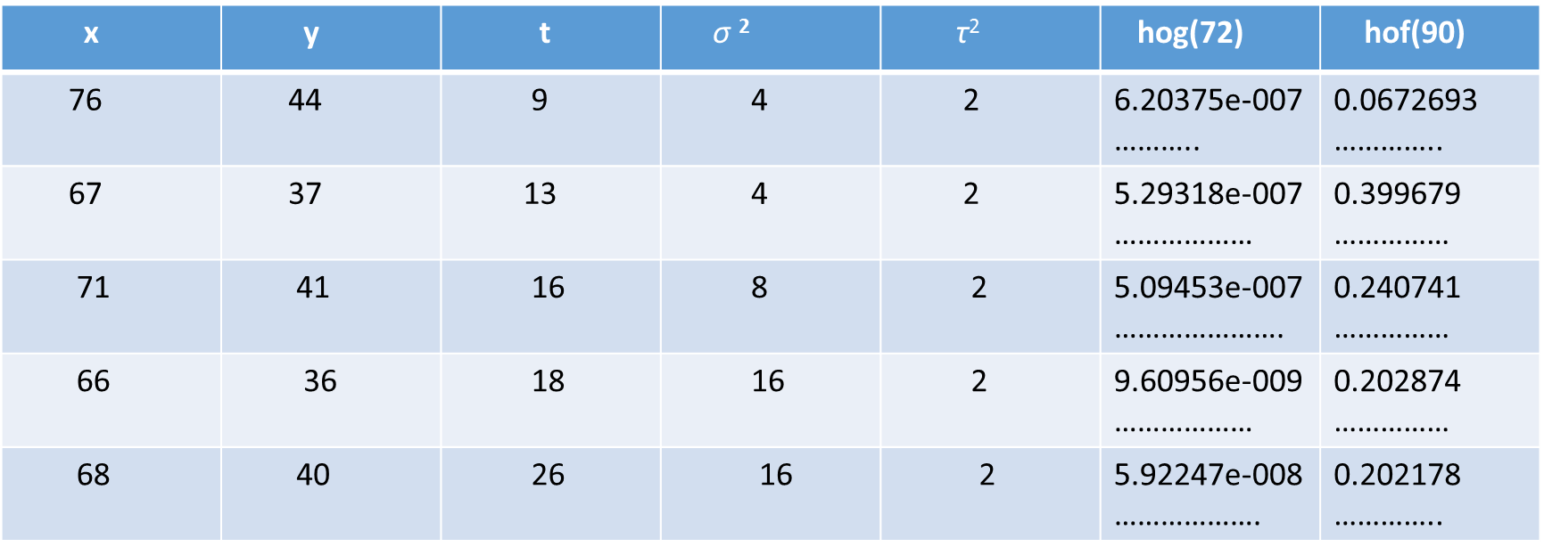
RESULTS: 1) Features

Slide 12
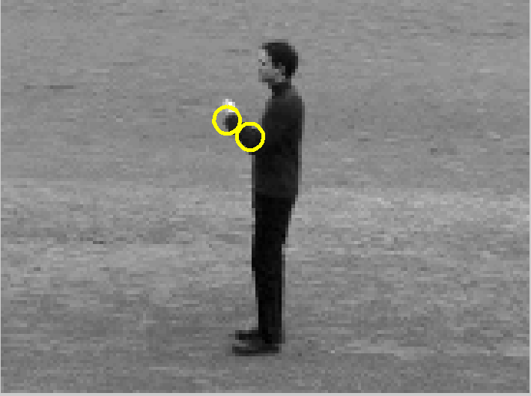
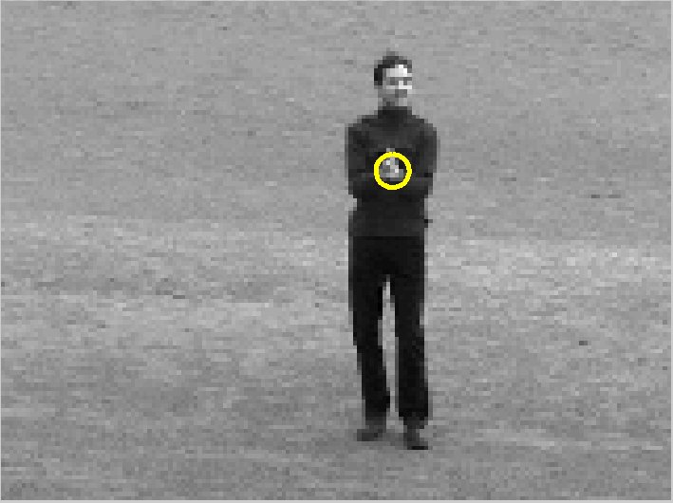
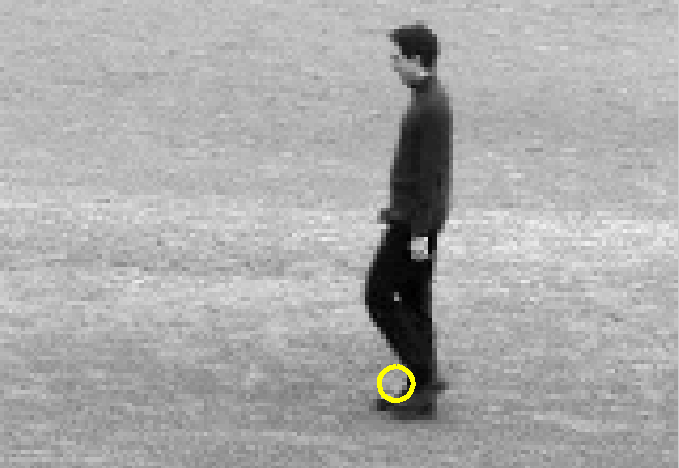
Interest Points
Boxing Hand Clapping Walking

Slide 13
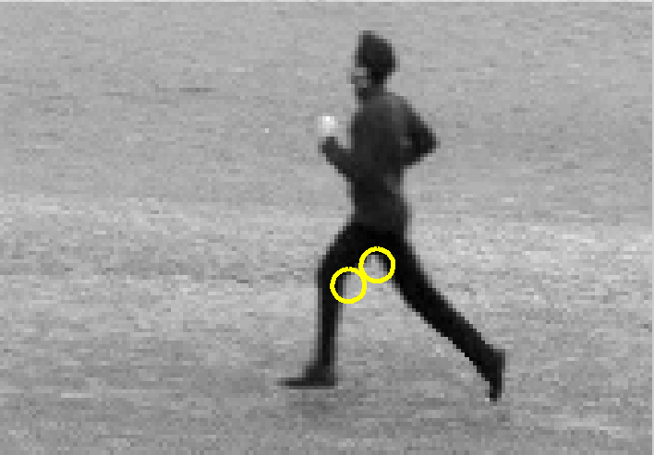
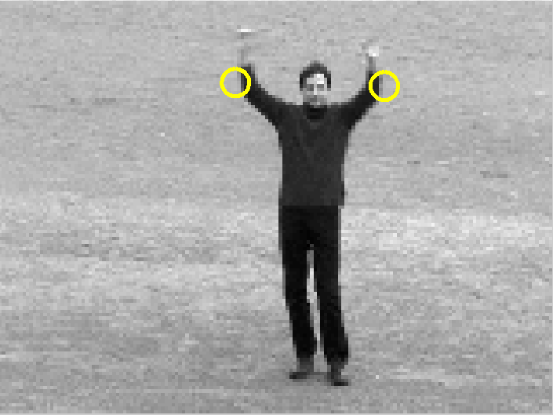
Interest Points
Running Hand Waving

Slide 14
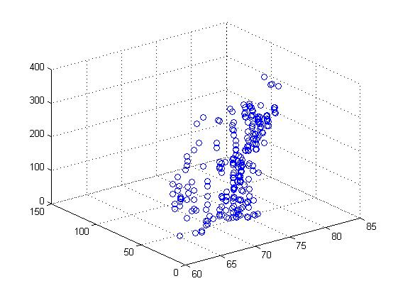
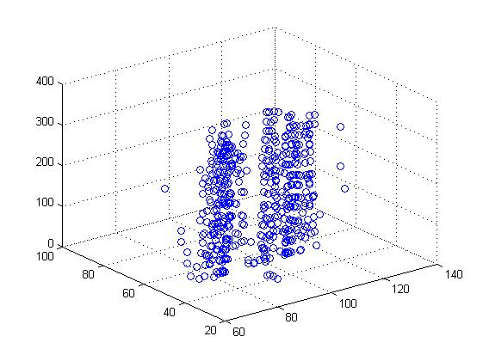
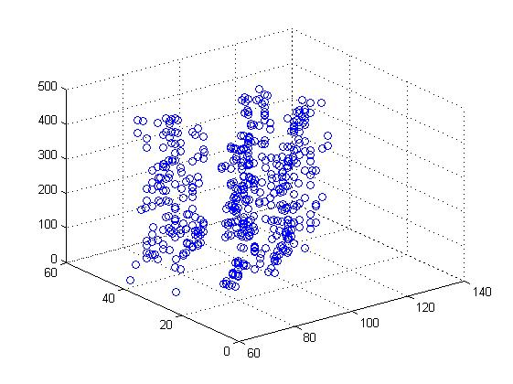
STIPs of a videos
Boxing
Hand Clapping
Hand Waving

Slide 15
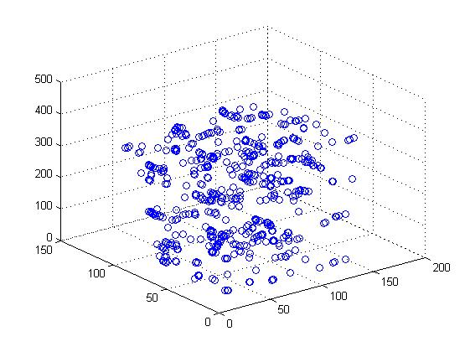
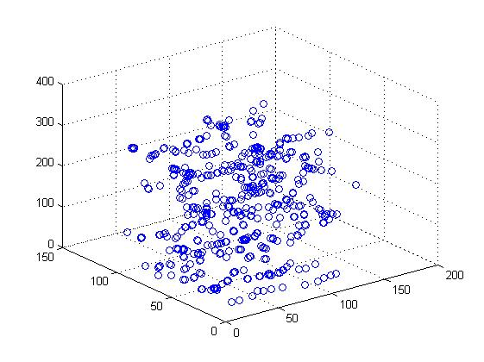
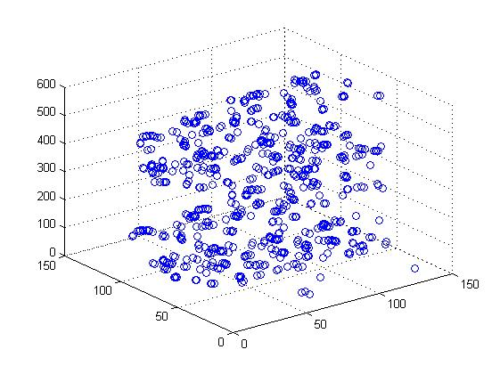
STIPs of a videos Cont..
Jogging
Running
Walking

Slide 16
2) Varying K-means clusters
1) When k-means clusters = 50
Accuracy = 86.5772% (Jogging)
Accuracy = 81.8792% (Boxing)
Accuracy = 87.9195% (Running)
Accuracy = 78.5235% (Walking)
Accuracy = 89.2617% (Hand Waving)
Accuracy = 85.2349% (Hand Clapping)

Slide 17
When it is 100
Accuracy = 83.2215%(Jogging)
Accuracy = 79.8658%(Boxing)
Accuracy = 81.8792%(Running)
Accuracy = 81.8792%(Walking)
Accuracy = 87.9195%(Hand Waving)
Accuracy = 81.2081% (Hand Clapping)

Slide 18
When it is 400
Accuracy = 86.5772% (Jogging)
Accuracy = 80.5369% (Boxing)
Accuracy = 84.5638% (Running)
Accuracy = 80.5369% (Walking)
Accuracy = 87.9195% (Hand Waving)
Accuracy = 85.2349% (Hand Clapping)

Slide 19
Thank You!!!

